Slide 1
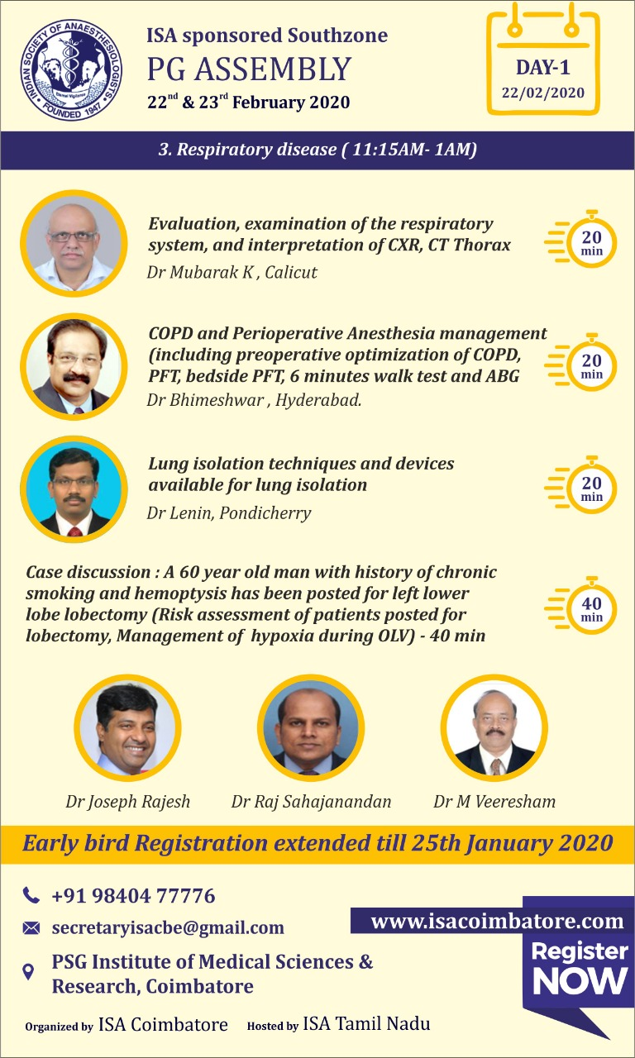

Slide 2
Q 1 How the history of the disease & personal history , habits of the patient is helpful in this 60 year old patient , chronic smoker with hemoptysis for lobesctomy of lung.
How to differentiate between heamoptysis and haemetemesis

Slide 3
Ans:Ans 1.H/o immune &allergy ,aspiration,airway obstruction,viral&Bacterial,aspergillosis infections,disorders , ciliarymotility,disorders of mucus secretions-cystic fibrosis,Mucovisidosis,Kartagenus syndrome and personal habits likeSmoking,Alcohol are the major contributing factors and somehabits(personal)are preventable for the disease, either partially or completely in the progress of the disease.

Slide 4
Q2. What is bronchiectasis, What are the clinical features of bronchactasis.what are the causes of bronchactasis & Typical symptom in bronchiectasis.how much is the sputum.

Slide 5
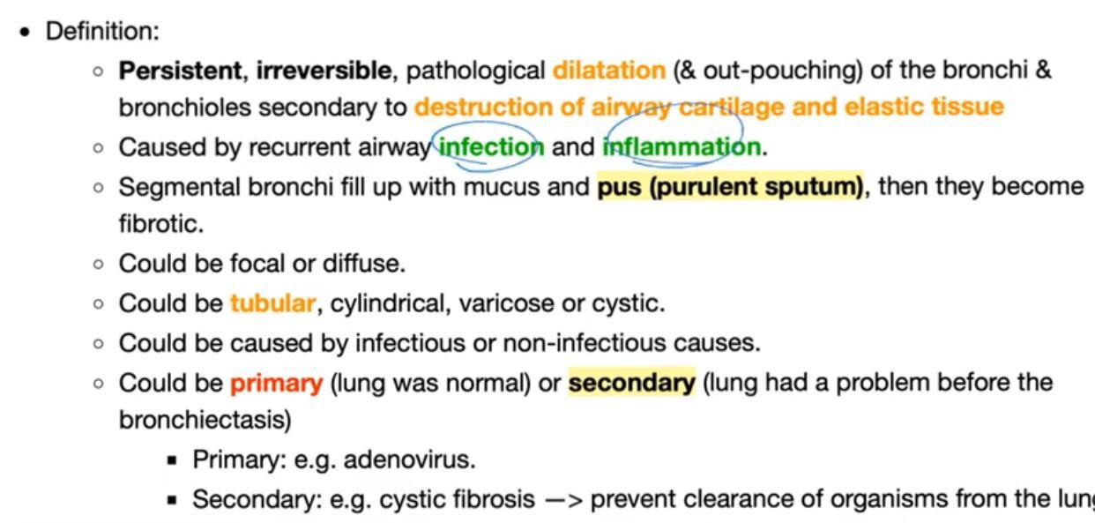
DEFINITION

Slide 6
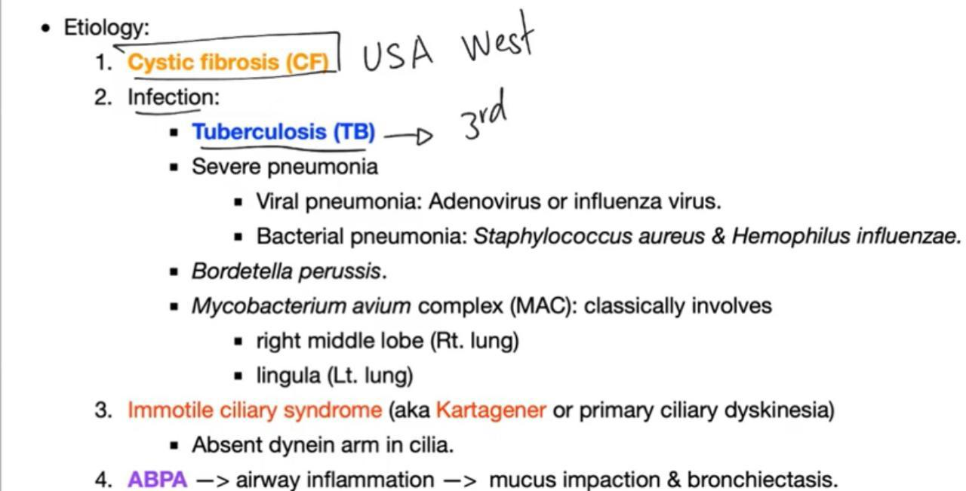

Slide 7
,SS:Chronicprogressivecough ,chestpain, sputum,mixedwithblood,phlegm,temp,wheeze,sinusites,malaise,fatigue,inability to do exercise and some times normal work in severe disease.recurrentinfections,deformity of nails,weight loss. sputum may be about 10 ml to 150ml or more per day depending on the seveority & type of etiology.

Slide 8
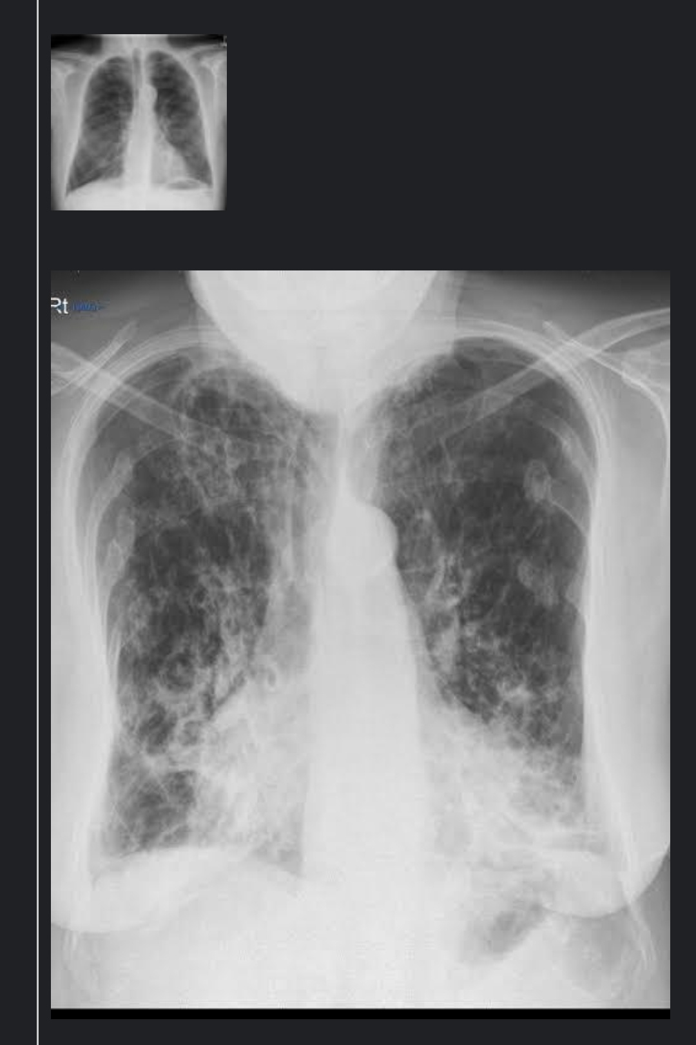

Slide 9
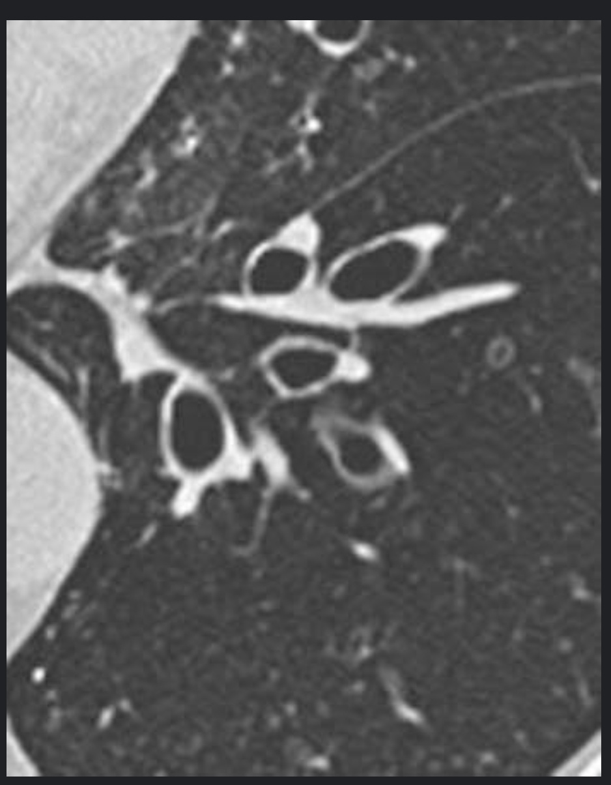

Slide 10
Q3.What are your concerns with bronchiectasis with lung resection?.Will you accept this case for surgery? When will you accept?

Slide 11
3 Ans:Depending on etiology of bronchactasis,is it localised or generalised like mucovisidosis,cycticfibrosis,anti trypsin deficiency,kartagenous accordingly and type of involvement of lung tissue and age of the patient and severity of the disease ,with investigation support & physiotherapy plan for the surgery.Cessation of smoking,treat the chest infection with appropriate antibiotics,long acting beta two agonists,antimuscarinic drugs both short &long acting,Steroids,Hydration &Mucolytic therapy,pulmonary rehabilitation,incentive spirometry,physiotherapy.

Slide 12
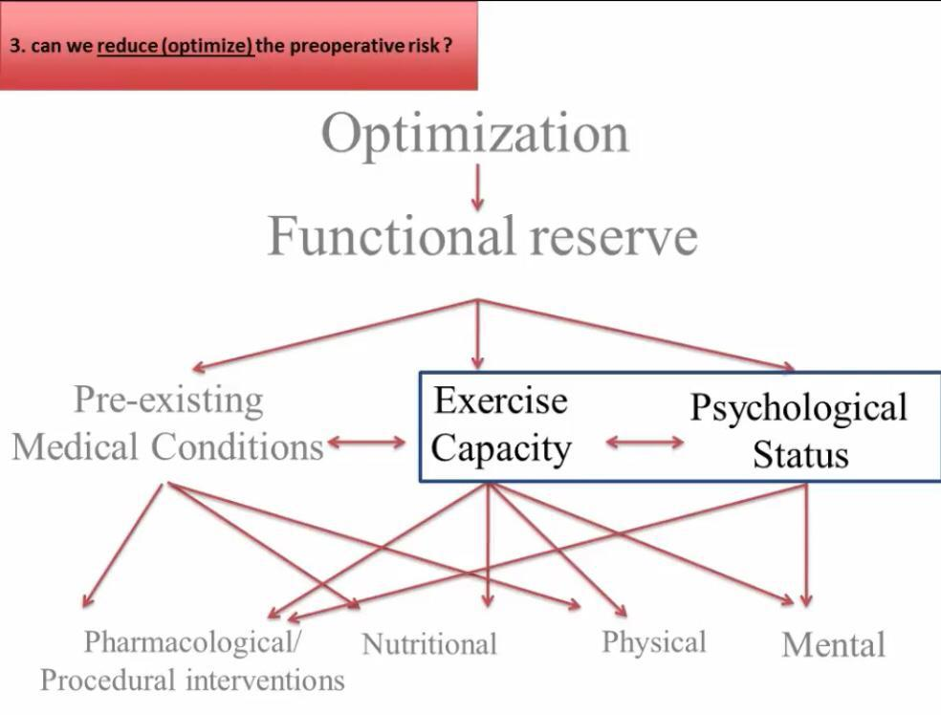

Slide 13
Q4.What laboratory investigations will you order for this patient and how they are useful in preoperative assessment in this patient.

Slide 14
4 .Ans:HB,ECG,CXR,BT&CT,
CT Chest 2DEcho,ABG,PFT,:FEV1,FEV1/FVC,FEV1 25-75,DLCO,Fibre -opticBronchiscopy(Diagnostic),exercise tolerance tes,6 mt walk test,viral profile,immunisation status for influenza,
Sputum for AFB& C/S.
These above tests with parameters will helpto know the how muchlung tissue is damaged help in fit ness for pre op assessment and post op complications

Slide 15
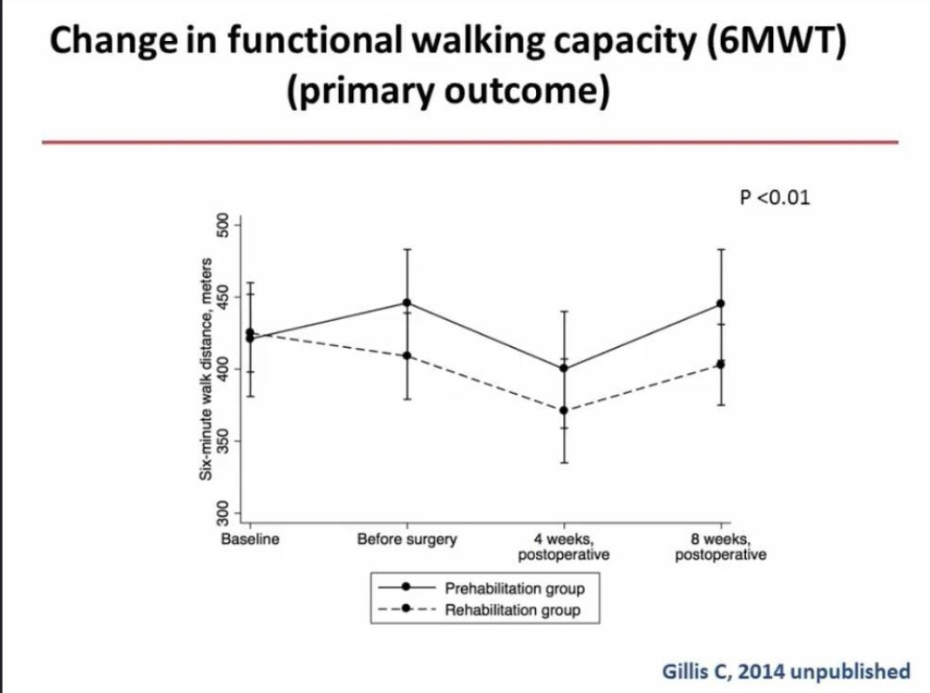

Slide 17
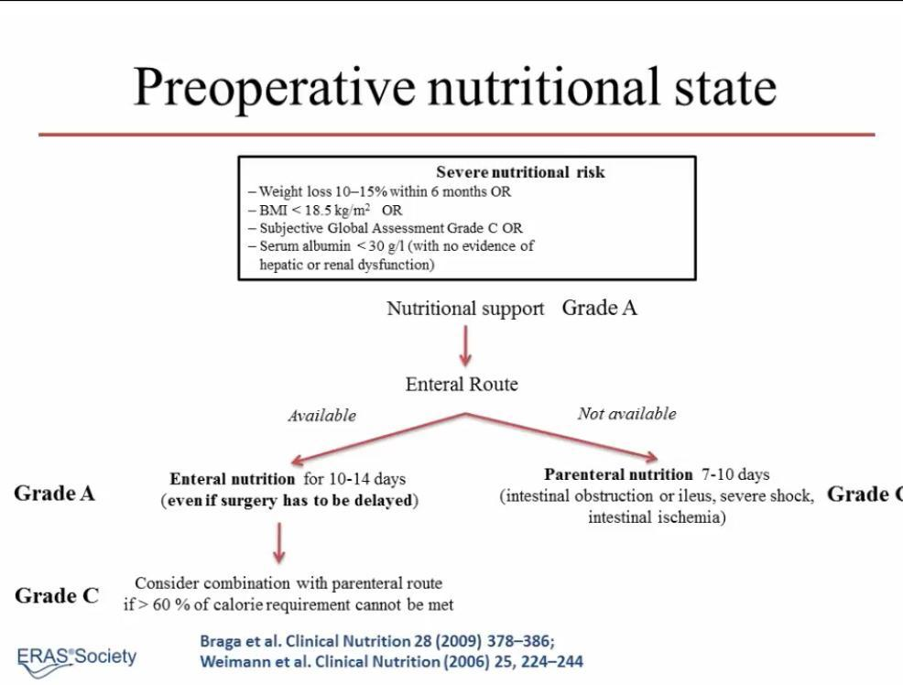

Slide 18
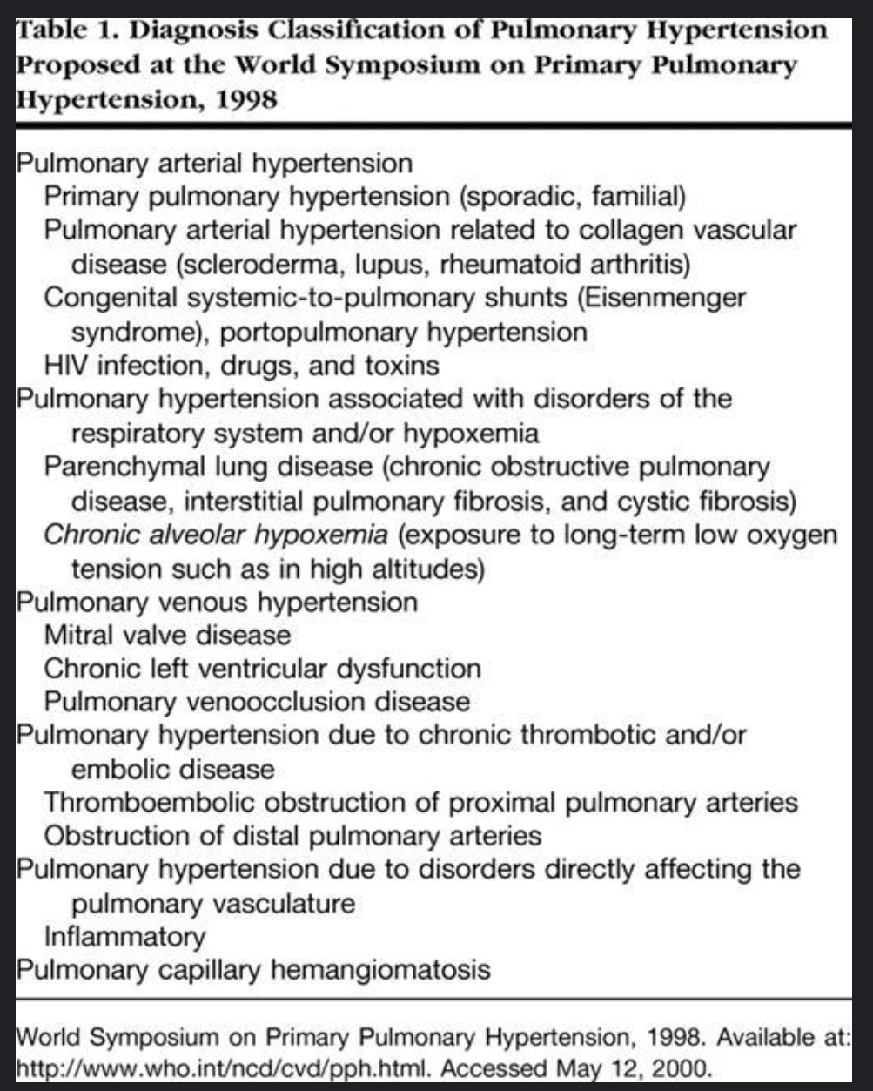

Slide 19
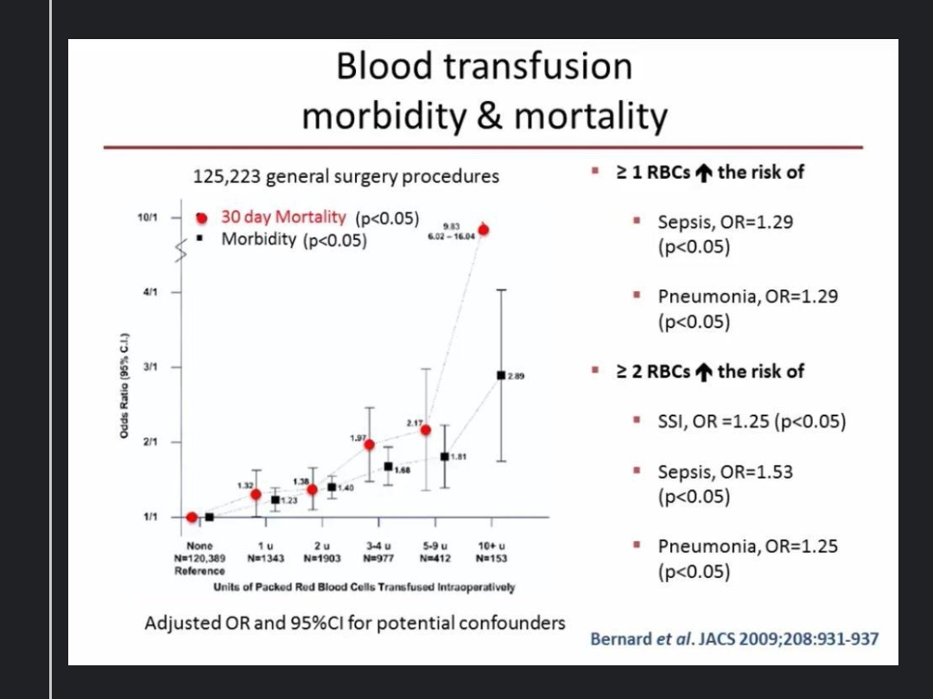

Slide 20
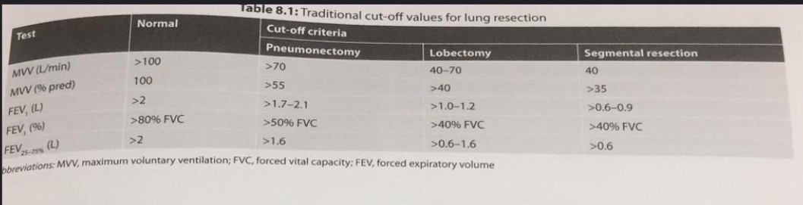

Slide 22
Q5.What are the causes of Anaemia in this case,Will you transfuse the blood.

Slide 23
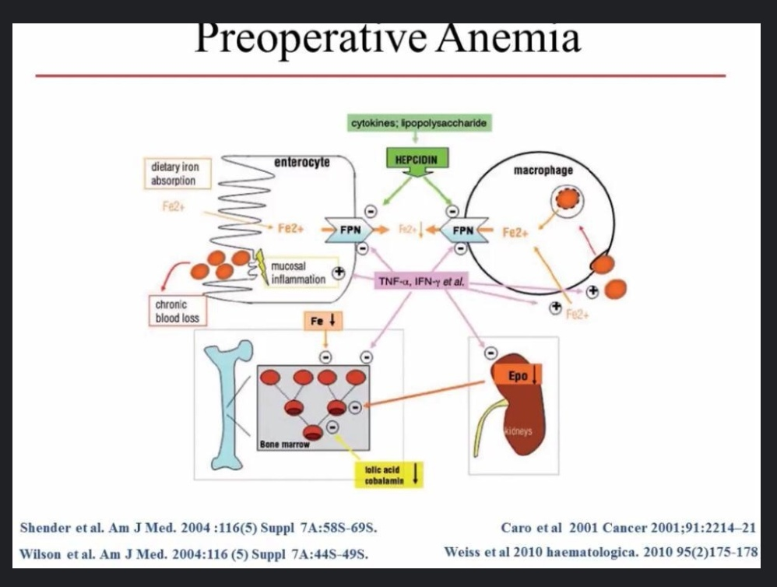

Slide 24
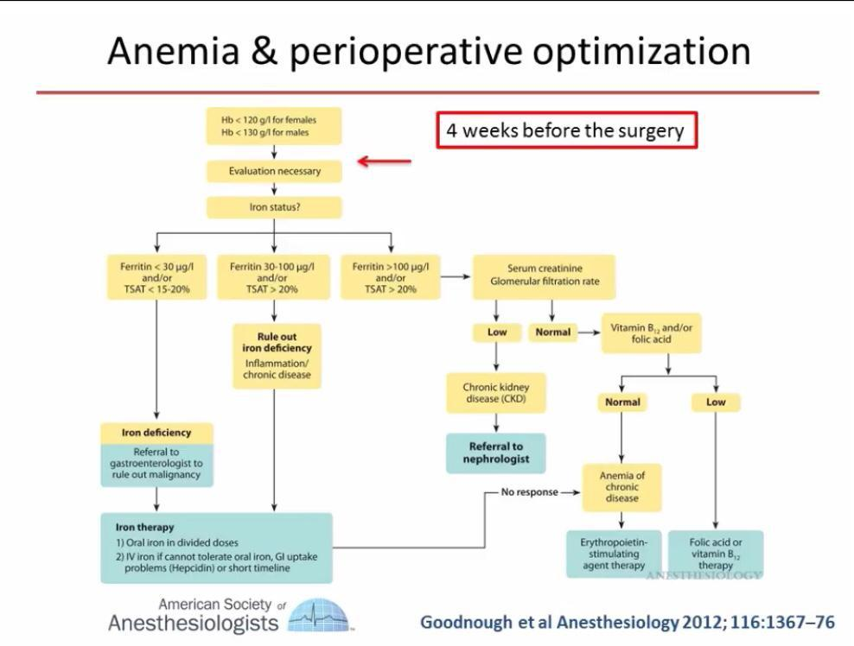

Slide 25
Q6.What are the CXR findings in bronchiectasis?What are the evidences of pulmonary hypertension in CXR?.
ECHO – when will you order echocardiography evaluation in this patient how will you assess the degree of pulmonary hypertension
Classify PHT, symptoms and anesthetic implication?

Slide 26
6Ans:CxR findings in bronchactasis Tram track,cylindrical,signet ring type opacities are seen in lungs .
Tram track appearance
Cylindrical in cystic fibrosis
Signet ring appearance opacities in lung tissue
All Anaesthesia drugs both I.V &Inhalational agents will decrease systemic blood pressure have deleterious effects on tissues oxygenation in PAH patients.Treatment of PAH depending on The etiology &plan for Anaesthesia &surgery.

Slide 30
Q7.ABG shows CO2 retention – what are the factors associated with high morbidity in thoracic surgery.HCO3 is 30, what are the risks of washing off CO2 intraoperatively.PFT – what is the use of PFT in these cases?
Describe the pulmonary function tests done at bedside how are they implied here in this patient.Describe the pre op measures to be taken to optimise this patient for the planned surgery and anaesthesia. ?
How will you do postural drainage? How will you drain right middle lobe by postural drainage

Slide 31
7.Ans:Permissive hypercapnia is allowable to prevent morbidity& mortality in the perioperative period .PFT-bed side Cough test,Wheeze test,Maximum laryngeal height,Forced Expiratory Time,BHT,Sniders match test,Single breath count test,PEFR,these tests will help to know the reserve capacity,Effort tolerance of lung tissue in this patient.

Slide 32
Q8.Will you do a sputum culture, how will it affect your management?.Will you delay surgery to treat infection?
Will you start prophylactic antibiotics?.How do you assess the tolerance of the proposed lung resection in this patient.
What will be your preoperative advice? How do you predict post op pulmonary complications.
When do you say this patient is unfit for Rt lower lobe lobectomy under anaesthesia.

Slide 33
8.Ans:we have to order Sputum for AFB,and for culture sensitivity to select &treat the diseases pre-operatively for successful outcome,if it possible better to delay the surgery,if the time is not adequate start prophylactic antibiotics .

Slide 34
9.Q. What are your Preop orders, premedication.What is the technique of anaesthesia you are planning?

Slide 35
9.Ans:Quit the smoking,alcohol,minimal anxiolytics,nebulisation,hydration,mucolytics,beta 2 agonists (selective),PAC-Airway,General examination,Required investigations .The surgery planned under GA withDouble lumen ET tube.
Epidural block for post op analgesia.

Slide 36
What is “ Three leg model” of assessing the patient posted for thoracotomy with regard to tolerability and outcome?
Three leg model
Respiratory mechanics
Lung parenchymal function
Cardio pulmonary reserve

Slide 37
Risk factors for post operative pulmonary complications
Respiratory mechanics
  FVC < 50%
  forced expiratory volume in 1 second (FEV 1 ) <2 L, and
  FEV1 /FVC <50%.
Predicted postoperative FEV1
  Most valid single test
  PPO FEV1 % = Pre opFEV1% X (1- functional sub seg to be removed /42 X100)

Slide 38
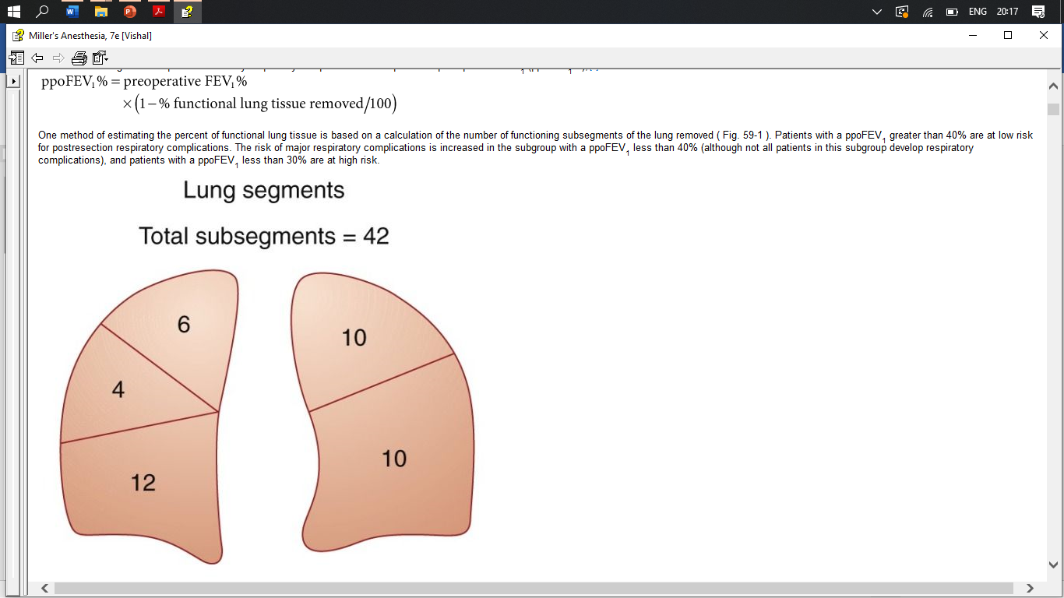
Respiratory Mechanics
For Left lower lobe 10/42 X 100 = 24%
if Pre op FEV1 is 55 %
  55% X (1-24) = 42%
  <40 : Risk factor for Post op complications
  < 30% are at high risk & Post op ventilation required

Slide 39
Lung parenchymal function
ABG parameters: (Gas exchange)
  PaO2 > 60 mmHg
  PaCO2 < 45 mmHg
DLCO (Diffusing lung capacity for carbon monoxide)
  Total functioning surface area of the alveolar-capillary interface
    > 60% : Adequate
    50 -60 : Needs further testing
    <40 % : Associated with perioperative complications

Slide 40
How to assess the Cardio pulmonary reserve?
V02 _{Max:} > 15ml/kg/mt
Stair climbing :
  Patient's own pace but without stopping for certain number of flights.( “flight,” but 20 steps at 6 in/step is a frequent value.)
  Five flights > 20 mL/kg/min,
  Two flights : 12 mL/kg/min. ( extremely high risk)
6 minute walk test
  < 2000 ft or 610 M : < 15 ml/kg/mt
Shuttle walk test
  Inability to complete 25 shuttles of 10 mt distance < 15 ml/kg/m
SpO2: fall > 4%

Slide 41
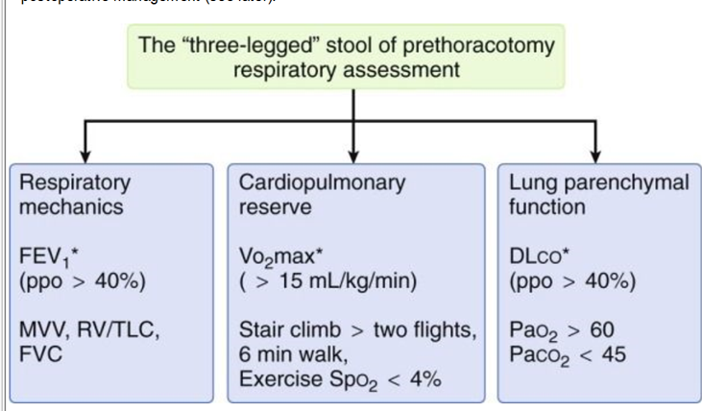
How do you assess the tolerance of the proposed lung resection in this patient.

Slide 42
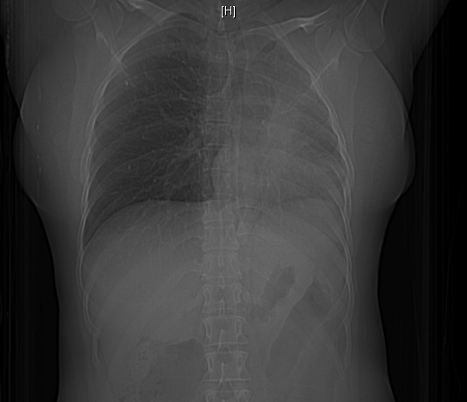
Role of Perfusion scan
Aim
  To predict the impact of resection on postoperative lung function precisely
  For patients who are deemed to be at high risk
Rational
  The involved lung tissue may contribute little to existing lung function
  Removal may not cause further deterioration of pulmonary function.
  High risk candidates may be considered after more specific evaluation.
(1- Perfusion to the resected lung) X Pre op FEV1

Slide 43
To summarize the risk factors
Pa CO2 >45 mm Hg
PaO2 < 60 mmHg
DLCO < 30 % predicted
PPO FEV1 < 30%
Inability to climb two flight of stairs /walk for 2000f in 6 minutes

Slide 44
What is your plan of anaesthesia for this patient ?
Preparation of the OR
  Necessary (Basic & specialized Airway Devices, Medication, Different adaptors, Resuscitative equipments & Drugs)
Good venous access
  Large bore cannula
  Central line on same side
Adequate Monitoring
GA with controlled ventilation with lung separation technique and epidural analgesia for post operative pain relief .

Slide 45
Monitoring

Slide 46
Anaesthetic technique
Good preoxygenation
Balanced anaesthetic technique
  Induction agent propofol preferred
  NDMR for intubation
  Opioids
    To obtund the response
  Laryngoscopy after adequate depth
  Oxygen in air/N2O with isoflurane for maintenance

Slide 47
Indications for
OLV

Slide 48
Describe the various techniques of lung isolation with advantages and disadvantages of each modality?
What lung separation technique you want to use for this patient?

Slide 49
DLT
Advantages | Disadvantages
Alternate between OLV & DLV, Intra operative suctioning, Apply CPAP if needed Repositioning rarely required, Placement without bronch scope possible | Not possible in patients with difficult airway or high risk of aspiration. Need to choose the right size Can induce Trauma Not suitable for post op ventilation.

Slide 50
Bronchial blockers
Advantages | Disadvantages
Selective lobar blockade is possible, Used in children & small adults, Easily added to regular ETT Allows ventilation during placement In difficult airways Post op ventilation | Small lumen, (? suctioning) Longer time to collapse Repositioning needed more often Bronchoscope essential for positioning

Slide 51
Single lumen tubes
Advantages | Disadvantages
Useful in emergency situations massive bleeding Difficult airways | Difficult to negotiate to the left lung. Bronchoscopy necessary for placement Does not allow for bronchoscopy, suctioning or CPAP to isolated lung

Slide 52
What are different sizes of DLT available and How to choose the DLT size?
If this patient’s height is 170 cm
Single use PVC tubes available sizes :
26, 28, 32, 35 37 39 41 F
Based on
Gender,
Height
CT /CXR based tracheal width,

Slide 53
Selection of DLT sizes
Gender: 35 Small female, 37 large female
39 Small male, 41 large male
Gender | Height (cm) | Size
M | >170 | 41
M | <170 | 39
F | >160 | 37
F | <160 | 35
Tracheal width (MM) | F
>18 | 41
16-18 | 39
15-16 | 37
14-15 | 35

Slide 54
Which side do you choose?
  Intubate the dependent side
  Always use left sided tube except in few conditions

Slide 55
Indications for RDLT
Distorted anatomy of the left main bronchus by an
intrabronchial or extra bronchial mass
Compression of the left main bronchus due to a descending thoracic aortic aneurysm
left -sided pneumonectomy
left -sided single lung transplantation
left -sided sleeve resection.

Slide 56
What do you mean by margin of safety & how it impacts in choosing the side ?
The right upper lobe bronchus takes off from the right main bronchus within very short distance from carina than left main stem bronchus
Hence the chances of occlusion of right upper lobe bronchus is high.

Slide 58
Describe the technique of DLT insertion and confirmation?
After the scopy insert the DLT with its concavity of distal curvature facing upwards.
Once the bronchial cuff passes off beyond larynx , turn the tube 90 degree to the left so that the proximal curve is faced anteriorly
Push till gentle resistance is felt and then inflate the tracheal cuff only
Approximate rule for fixing the length.
  170 cm : 29cm and adjust 1 cm for every 10 cm change in height.

Slide 59
How do you confirm the correct position of the tube?
Manual:
  With inflation of tracheal cuff , bilateral ventilation should be possible and equal
  If only one side is ventilated : tube is too far in and withdraw the tube by few cm and confirm the bilateral air entry,.
  Inflate the bronchial lumen slowly with maximum of 2- 3 ml of air. And confirm the bilateral air entry.
  If only left lung is ventilated means bronchial cuff is obstructing the contralateral (Right) lumen
  Then to clamp each side selectively and watch for absence and presence of clear breath sounds in intended side.

Slide 60
Bronchoscope
1. Introduce the bronchoscope (3.6 /4.2 OD) through tracheal lumen
  Carina is visualized
  Bronchial limb entering into respective bronchus
  Colour coded bronchial cuff is seen- but not above the carina or too far inside the main stem bronchus
  Inflate the BC to see cuff not herniating into tracheal lumen.
2. Introduce the bronchoscope through left bronchial lumen and visualize the left upper lobe.
  For right sided (should show alignment of the endobronchial side portal with the opening of the right upper lobe bronchus

Slide 61
Ultrasound ?

Slide 62
What are the complications of DLT?
Malposition: ( Failure to oxygenate / Collapse)
  Tube tip is too distal
    bronchial cuff can obstruct the left upper or
    the left lower lobe orifice (Segmental collapse)
  Tube tip is too proximal:
    Occlude the tracheal lumen
  Tube is in the right bronchus (the wrong side)
Trauma
  minor insults, such as ecchymosis of the mucous membranes to severe insults such as arytenoid dislocation and vocal cord rupture or catastrophic tracheobronchial rupture

Slide 64
Positioning
Aim:
To facilitates surgical exposure & avoid injuries
Technique:
Lower arm is flexed and the upper arm is extended in front of the head, pulling the scapula away from the field
Slight flexion at dependent hip and knee
Pillows are placed between the arms and legs
Axillary (chest) roll positioned just beneath the dependent axilla to reduce pressure on the inferior shoulder
To avoid pressure on the eyes and the dependent ear ,cervical spine (neutral position)

Slide 65
One lung ventilation
Describe physiology of one lung ventilation?
What is HPV?
Effects of anaesthetic agents on HPV and their clinical implications?

Slide 66

Physiology of one lung ventilation- Summary
Awake spont
Anesth Both LV
Anesth OLV
40%
40%
20%
HPV response
60%
80%
60%
%-Blood Flow
- Preferential Ventilation
PaO₂ N (550)
PaO₂
(400)
PaO₂
(150)
PaCO₂ N

Slide 67
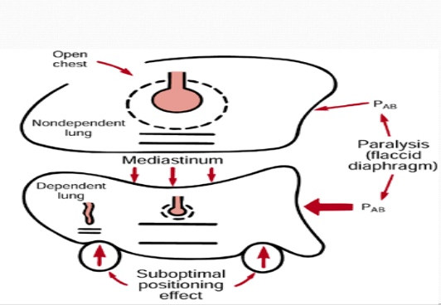
Hypoxia during OLV
Operated lung
  Shunt
Dependent lung
  Reduction in lung volume & FRC
  Absorption atelectasis
  Collection of secretions
  Accumulation of fluid transudate in the interstitium
Notes:
Anesthesia and Paralysis
Pressure of Abd contents on dep. Diaphragm
Weight of Mediastinal structures
Suboptimal position during surgery

Slide 68
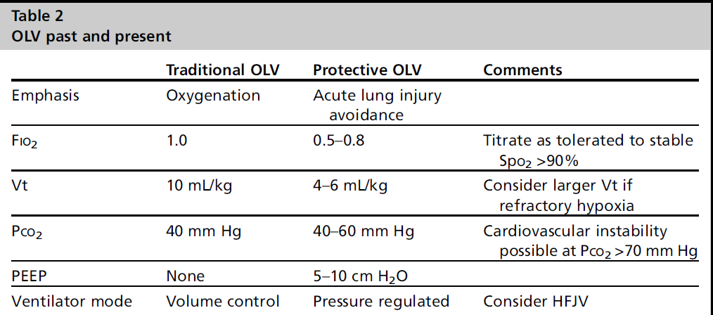
Ventilatory strategies for OLV
Notes:
Still controvorsial. Animal model TIVA has advantages
Iso inhibits HPV and increase shunt. But the decrease in CO due to Iso decrease the blood flow to non dependent lung. End result no clinically significant worsening of oxygenation
Sevo – attenuates the inflamatory effects of OLV

Slide 69
Hypoxia in OLV
You have isolated the lung with a left DLT and has started the procedure , after OLV there is desaturation to 84%?
  What is the management of hypoxemia during one lung ventilation?

Slide 70
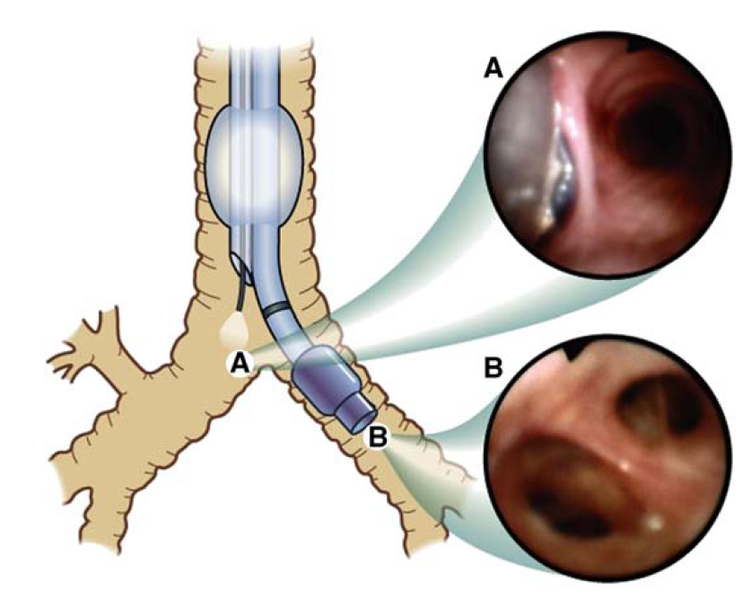
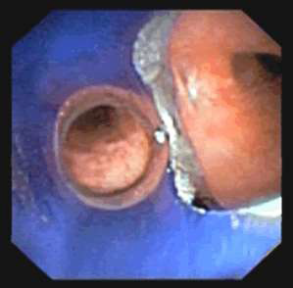
Management of Hypoxia during OLV
Prevention
  Correct position of DLT
  Clinical confirmation
  Airway pressures
  FOB confirmation
Appropriate ventilation strategies
Identifying at risk patient and planning
Notes:
( if airway pressures increase significantly with initiation of OLV – quite likely that your tube is too much in on left side – ventilating only one lobe, RUL is not alligned)

Slide 71
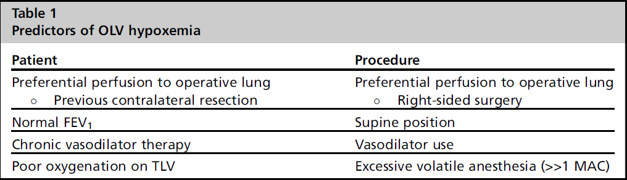
Who is at risk

Slide 72
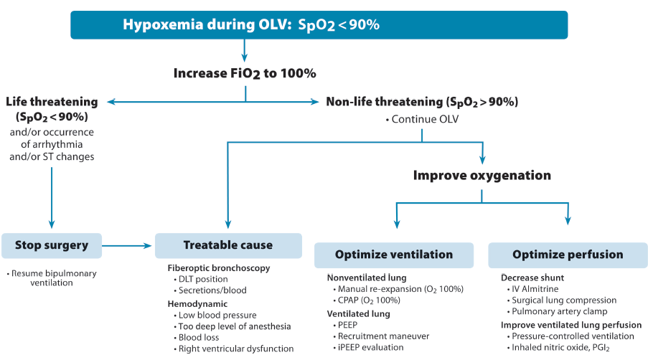
Hadrien Roze, Case Scenario. Intraop hypoxia during OLV. Anaesthesiology 2011
Notes:
In case of severe hypoxia <90% saturation, STOP Sx, Inflate the lung with hand bag with 100%O2 with a pressure of 20 -30 cmH2O, the reexpansion of the collapsed lung is visual. Once a satisfactory oxygenation is achieved do two things – R/O a reversible cause and improve oxygenation

Slide 73
Fluid management in thoracic surgery
Notes:
Stress response to surgery cause Na and H20 retention mediated by ADH and RAA. Result in weight gain and edema formation which is a frequent complication of major surgeries . Incidence is about 40%
Crystalloid load is given to rx fasting, 3rd space, compensate for anesthesia induced hypotension

Slide 74
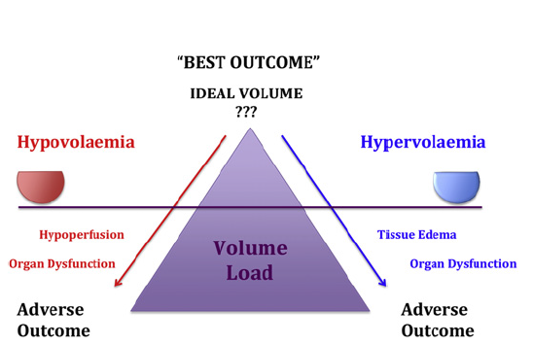
Optimal fluid management
Give carbohydrate laden solution till 2 hours before
No need to replace fasting and 3rd space
Restrictive fluid regimen
Vasoconstrictors
Colloids
Fluid balance in 1st 24 hrs not more than 20ml/kg
No need to maintain urine output > 0.5ml/kg
Goal directed therapy
  Esophageal doppler

Slide 75
You are cruising well with a stable SpO2 of 94%, suddenly you heard the surgeon shouting that the lung has come up, what is your DD and how will you manage?
Assuming that a left DLT was inserted – the most probable malposition is DLT slipping out ( too out) resulting in loss of lung isolation or it has slipped and entered the right side

Slide 76
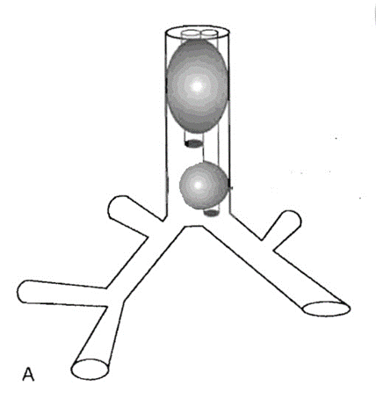
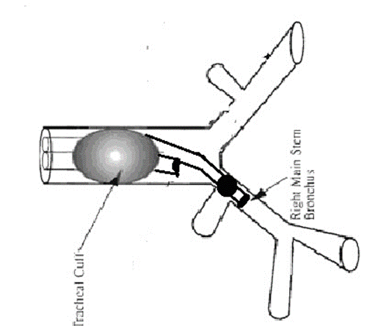
Malpositions (Too much out & Opposite side)
Issues : loss of lung collapse on operated side
loss of lung isolation resulting in
contamination of opposite lung which is dependent
Action : inform the surgeon, call for help & FOB
Try additional inflation of bronchial cuff
Immediate suction, ask the surgeon whether he can feel DLT in LMB
if not Deflate the bronchial cuff & advance
Ideally by FOB – go through bronchial lumen- identify primary carina - reposition

Slide 77
Suddenly you have noted that ETCO2 trace has disappeared, patient has started to desaturate, what will you do?
On bag ventilation you have realized that you can’t ventilate, what will be your next step?

Slide 78
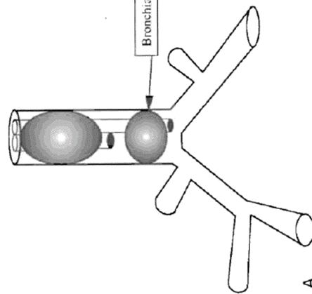
Malposition – too Out
Loss of lung isolation – contamination of healthy lung
High Paw – as bronchial cuff if occluding tracheal lumen
When you encounter high Paw
1. Rule out
Secretions/ blood
bronchospasm ( EtCo2)
  This reestablishes ventilation to either one lung/ both lungs
Bronchoscope through bronchial lumen. If you see carina – DLT is too out. Deflate the tracheal balloon and advance the DLT to desired bronchus

Slide 79
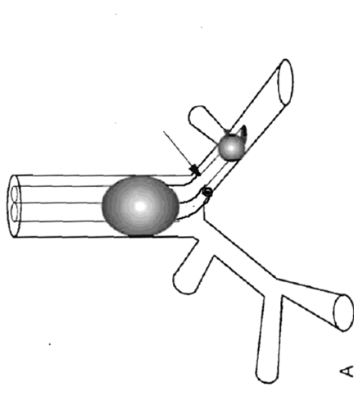
Malposition – Too much in
High Paw – desaturation, bag too tight
Inform the surgeon 100% O2, call for help & FOB
Suction to r/o Secretions/ blood
Look for and Rx bronchospasm
Deflate the bronchial cuff and unclamp bronchial lumen. This reestablishes ventilation to either one lung/ both lungs
FOB through bronchial lumen. If you see carina – DLT is too out.
If carina is not visualized withdraw till you see carina and advance into desired bronchus

Slide 80
Surgeon feels
“need to proceed with Pneumonectomy”
What is your plan ?
Recalculate the PPOFEV1
  (1-20/42) X 55 = 28.8
Good suctioning
Pull the bronchial extension back into trachea

Slide 81
Does this patient need post op ventilation?
No
This patients predicted post operative FEV1
(1- 10/42) x 55 = 41.9%
As it is more than 40% he can be extubated
  Ideally we need to count only the functional segments – if the left lower lobe is totally destroyed the pre op FEVI will have only minor changes secondary to pain and inflammation

Slide 82
Why it is important to control pain?
How do you manage the post op pain relief?
Thoracotomy is often performed in patients with preexisting lung disease such as lung cancer and COPD.
It is associated with the potential for severe pain, further impairment of lung function, delayed recovery and the occurrence of chronic pain.
Post operative pulmonary complications are important cause of morbidity and mortality

Slide 83
Post operative pain management
Epidural – gold standard
  Advantage – excellent pain relief, attenuates stress response preserve lung and GI function
  Disadvantage – hypotension, motor weakness, urinary retention, ipsilateral shoulder pain
Notes:
Epidural – excellent pain relief, attenuates stress response, accelarates recovery of pulmonary and gastric function, minimises systemic opioid use and their side effects
Disadvantage – fluid loading, catherization, delays mobilization

Slide 84
How will you establish Thoracic Epidural Analgesia in this case?
I will explain the postoperative analgesia options and take consent
I will check Platelet count PT, aPTT, TC DC to rule out infection and coagulation abnormality
Establish 16 G iv and 20 G arterial line and ASA std monitoring
Position – sitting up, feet rested on a foot stool, head flexed, assistant supporting
Identify T6 – 7 space . Inject lignocaine 2% to topicalize
Paramedian/ Midline approach – use 18 G touhy needle LOR technique. Advance the catheter 3 -4 cm into the space. Test dose with 3 ml 2% lidocaine with 5 mcg/ml adrenaline
Give additional 3 ml 0.25% bupivacaine – look for segmental analgesia from T3 to T8

Slide 85
Other Methods
Intrathecal morphine ( 200 -500 mcg, preservative free)
  Significant analgesia for about 24 hours
  Pruritus (35%) nausea (25%) respiratory depression (3%)
Intercostal nerve block
  Multiple level(5)
  Not very effective for chronic pain
Intravenous opioids
  PCA/ painbuster or dorsifuser
NSAID
  Ipsilateral shoulder pain
Multimodal
Fascial plane blocks
Notes:
Significant analgesia at both rest and coughing

Slide 86
Can you compare TEA with Thoracic PVB?
Paravertebral block
As efficacious as epidural
Less block failure
No hypotension, urinary retention, motor weakness
Timing – land mark/ USG or surgeon
Safe in coagulopathy
CI - infection
Notes:
TEA is often done awake to make sure that there is no neurologic sequele. Paravertebral owing to the non central location and being a much more expandable state can be blocked either at the beginning by anesthetist or at the end by surgeon under direct vision.

Slide 87
Ultrasound (US)-guided erector spinae plane (ESP) block – fascial plane block
local anesthetic (LA) is deposited either superficial or deep to erector spinae muscle (ESM
deeper plane deposition close to the midline at the tip of transverse process favors the spread through costotransverse foramina to both dorsal and ventral rami of the thoracic spinal nerves.
both cephalad and caudad LA spread is facilitated by the thoracolumbar fascia, which extends across the whole of the posterior thorax and abdomen, and is continuous with the nuchal fascia in the neck

Slide 88
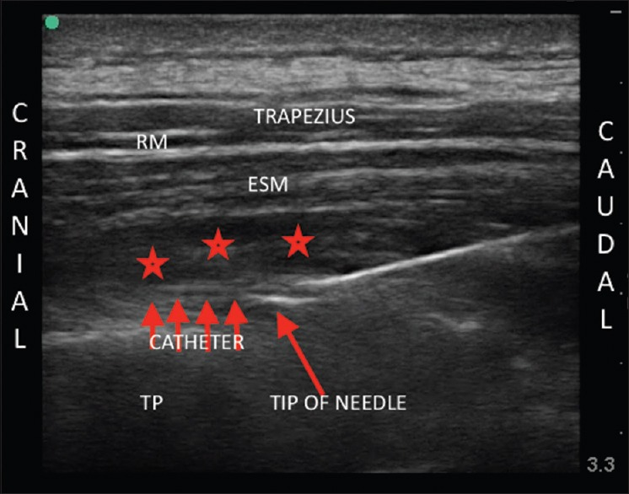
Erector spinae block with catheter

Slide 89
Ultrasound-Guided Serratus Anterior Plane Block
Targets the plane above or below the serratus anterior muscle in the midaxillary line
Provide analgesia to a hemithorax by blocking the lateral branches of the intercostal nerves
Avoid autonomic blockade associated with TEA and the risk of serious complications involving the pleura and central neuraxial structures.

Slide 90
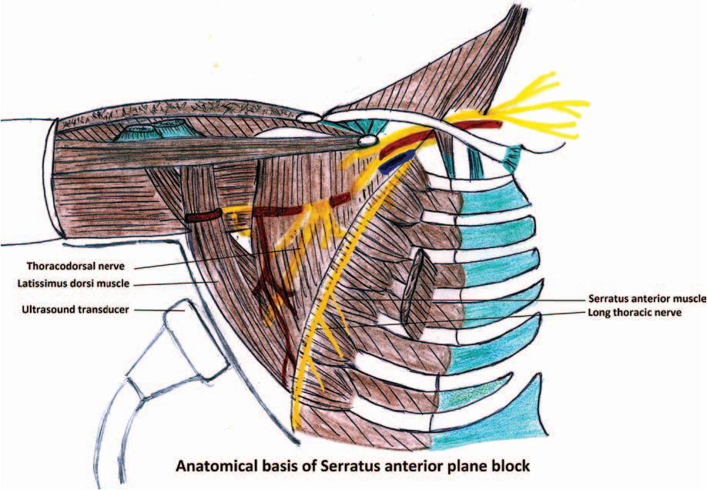
Serratus anterior plane block

Slide 91
What are the things you can suggest to the surgeon to reduce post thoracotomy pain syndrome?
Intercostal nerve damage – rib retraction
Posterolateral thoracotomy results in more damage than a muscle sparing thoracotomy
ICN damage by pericostal sutures ( 5th & 7th rib) – instead of going below 7th rib – make holes and go through 6th rib
VATS

Slide 92
What are the post operative complications you expect in this patient?
Post operative pain
Atrial fibrillation
Right ventricular dysfunction
Bronchopleural fistula
Vocal cord injury
Wound infection & dehiscence
Prolonged air leaks
Bleeding
Empyema thoracics
Atelectasis, bronchospasm – pneumonia
Type 2 respiratory failure ( Pain, COPD, narcotic effect)
Post pneumonectomy
Non cardiogenic pulmonary edema ( ALI)
Stump dehiscence
Cardiac herniation

Slide 93
6th August
Workshops
7th August
CME
8th & 9th August
Conference proceedings

